Slide 1
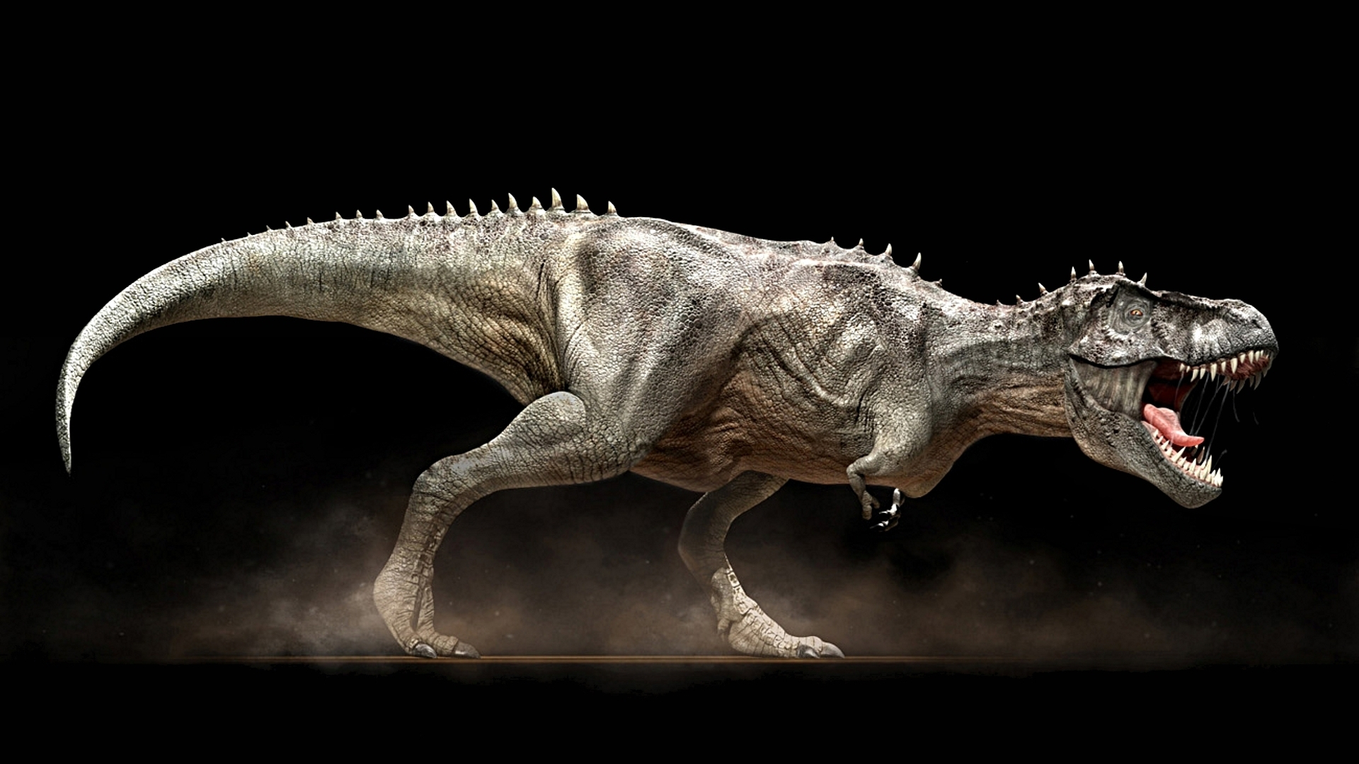

Ontogenetic dietary partitioning in Tyrannosaurus rex- Adam Kane

Slide 2
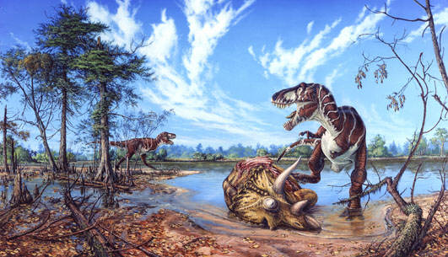
Scavenger

Slide 3
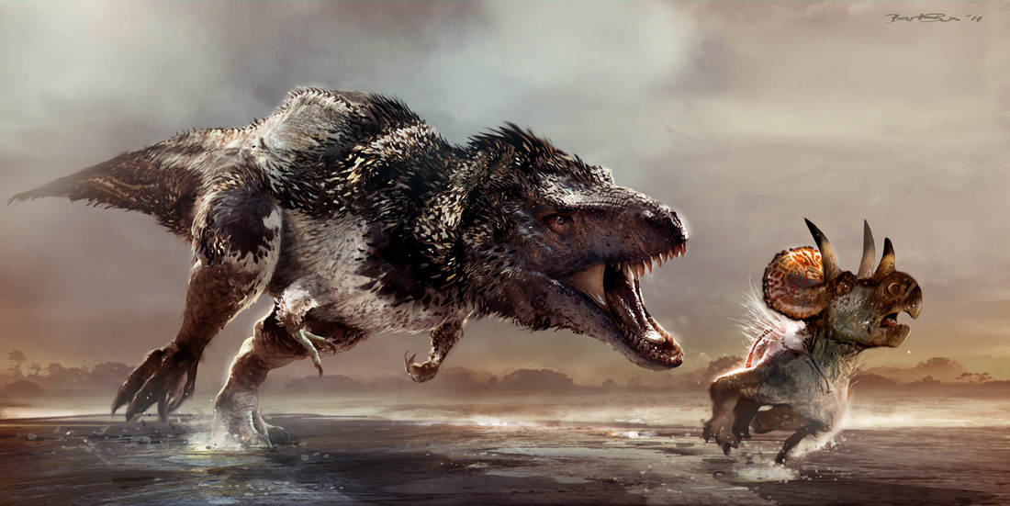
Predator

Slide 4
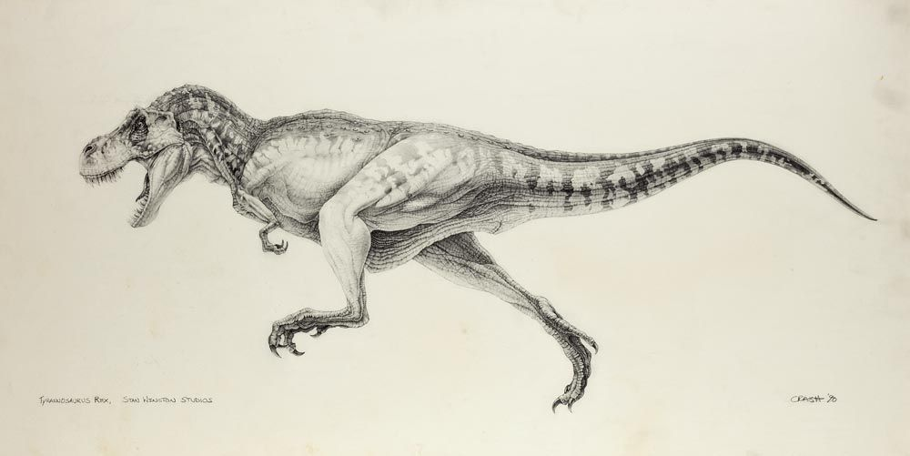
Tyrannosaurus rex
Crash McCreery

Slide 5
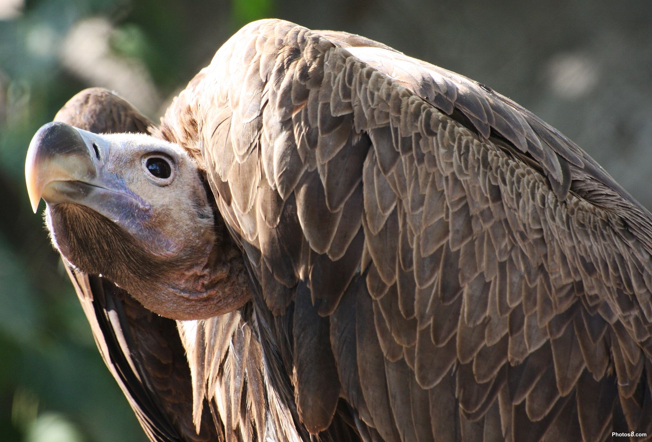
Pure Scavengers are Rare

Slide 6
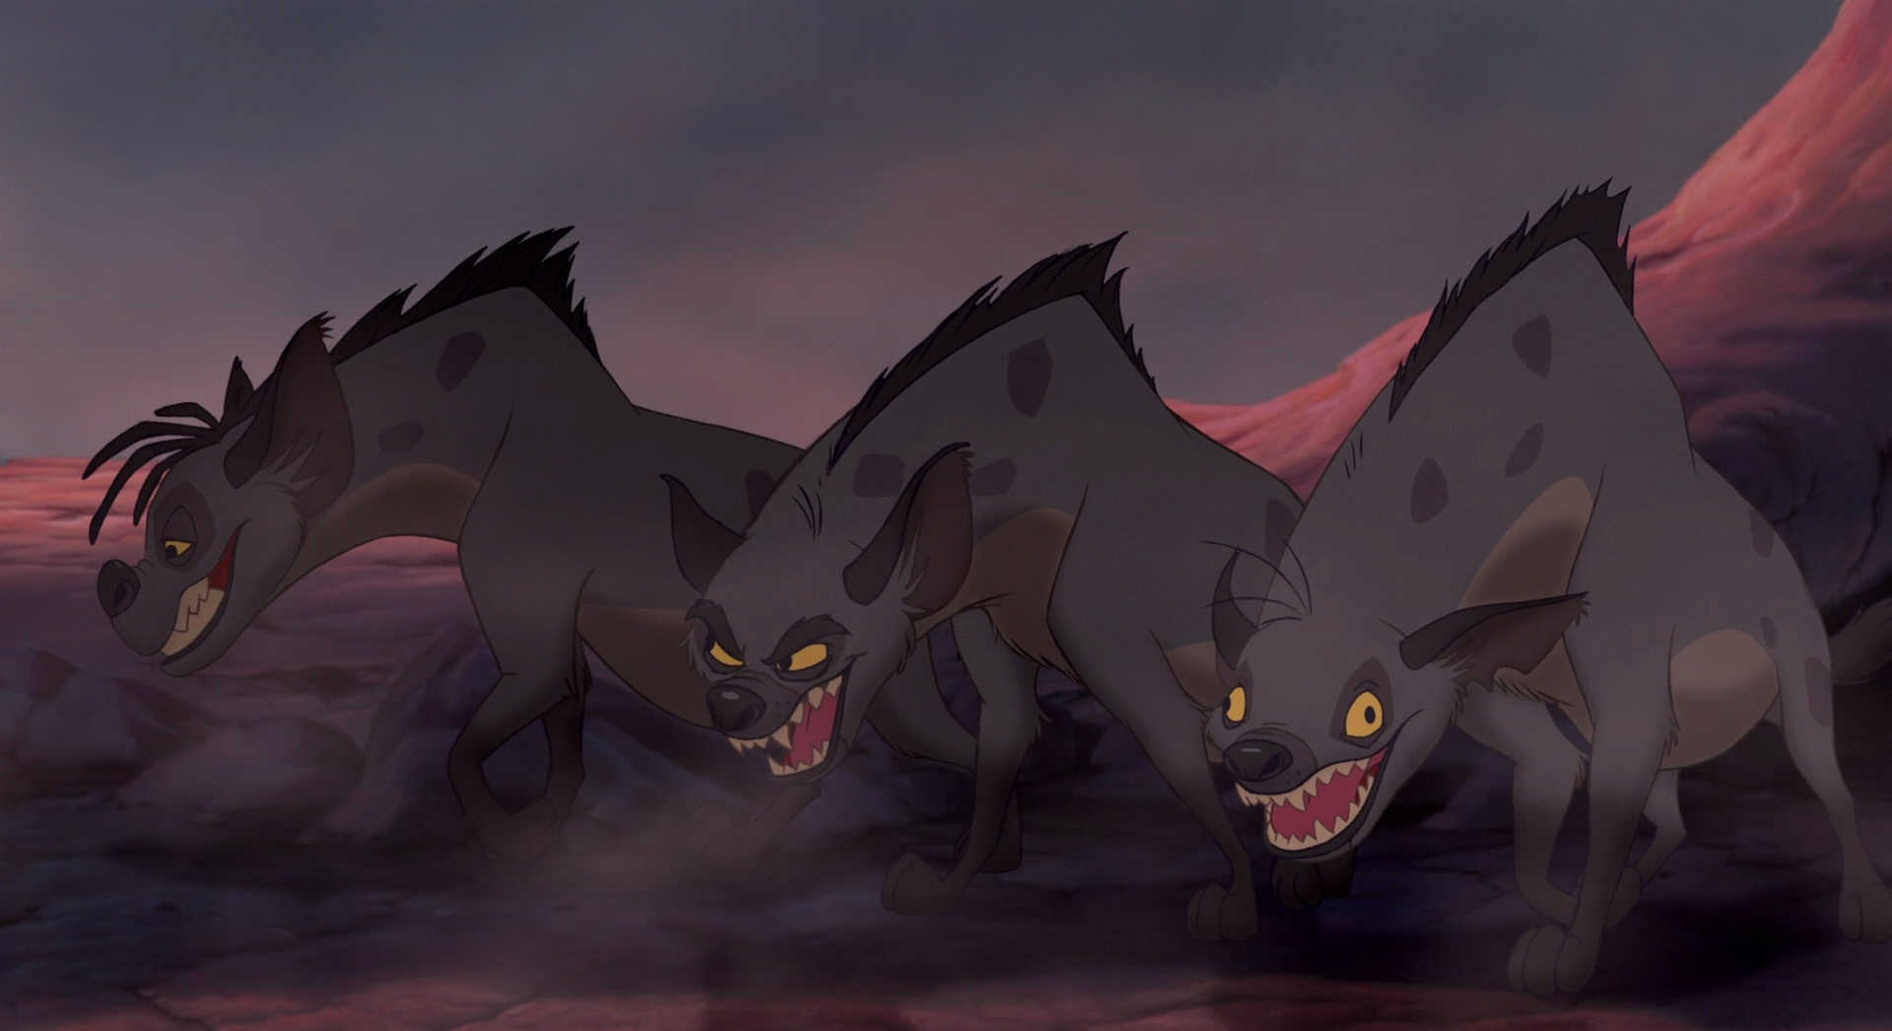
So was it both?
Notes:
Hyena pic

Slide 7
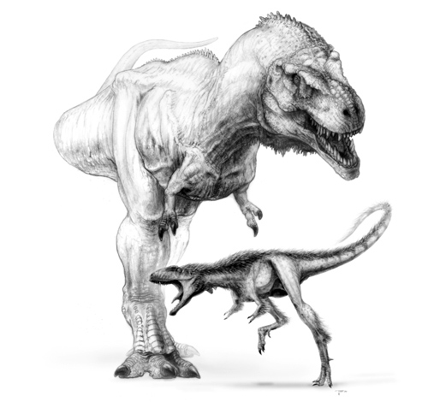
Ontogeny
Todd Marshall

Slide 8
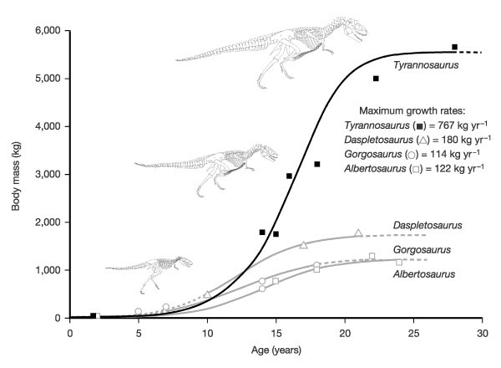
Tyrannosaur growth curve

Slide 9
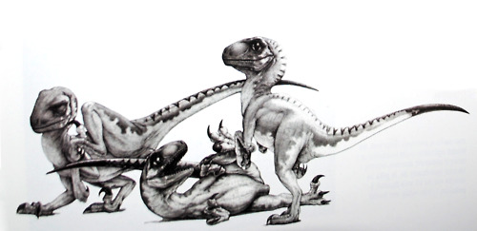
Competitors
Crash McCreery

Slide 10
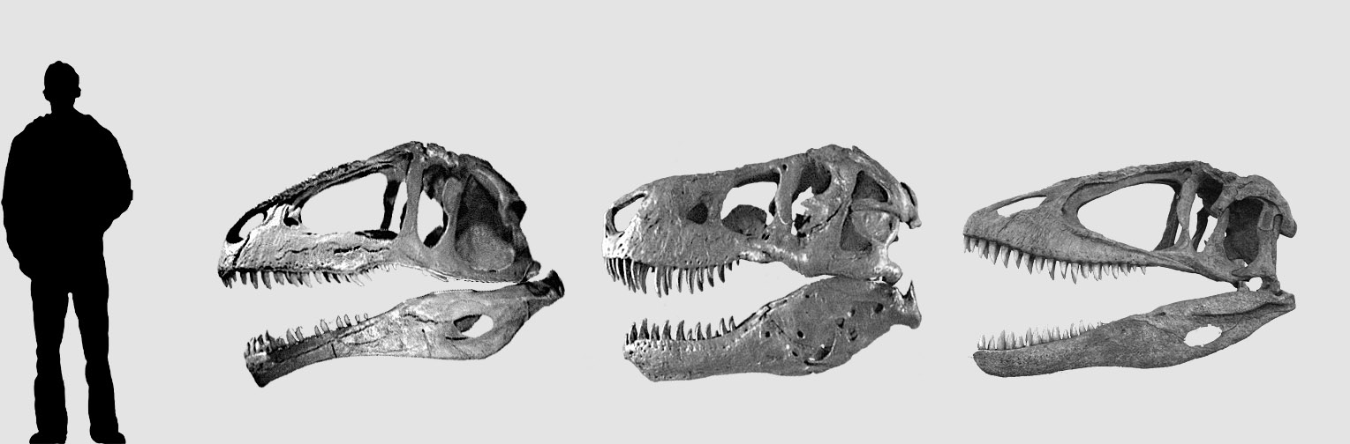
Skull Comparison
Giganotosaurus
Tyrannosaurus
Carcharodontosaurus

Slide 11
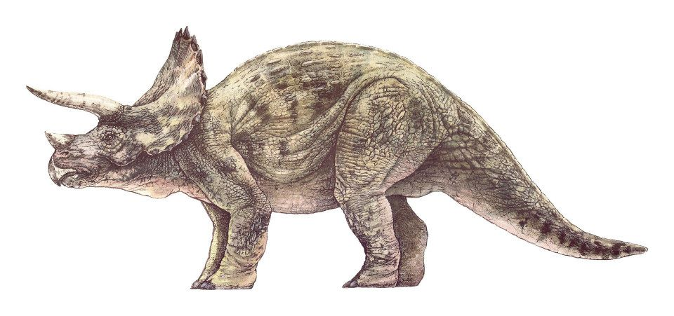
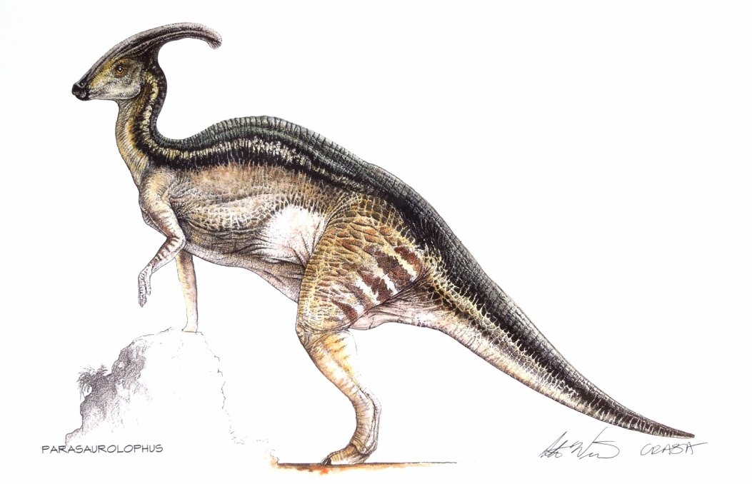
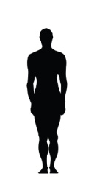
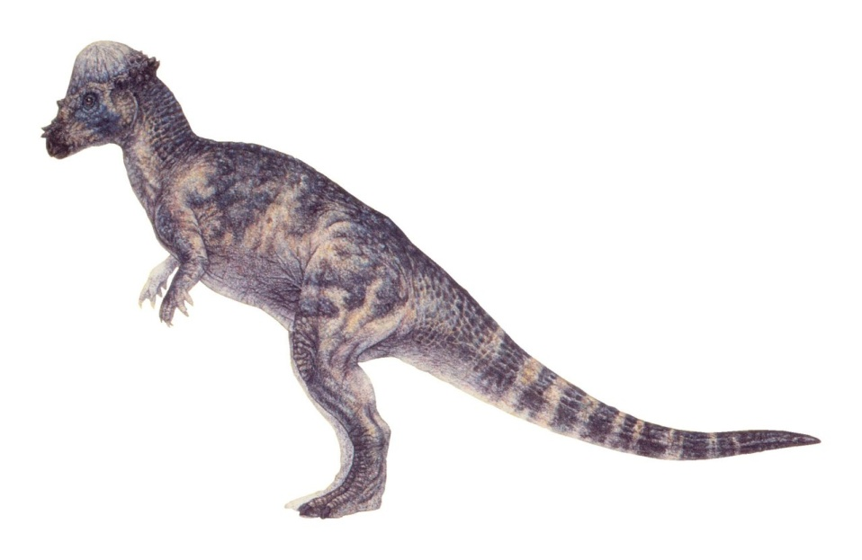
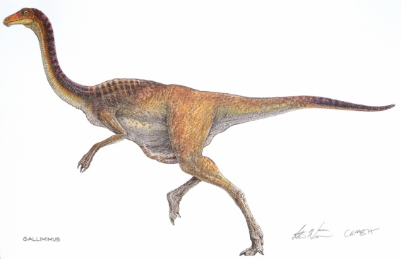
Prey
Crash McCreery
Notes:
Scale

Slide 12
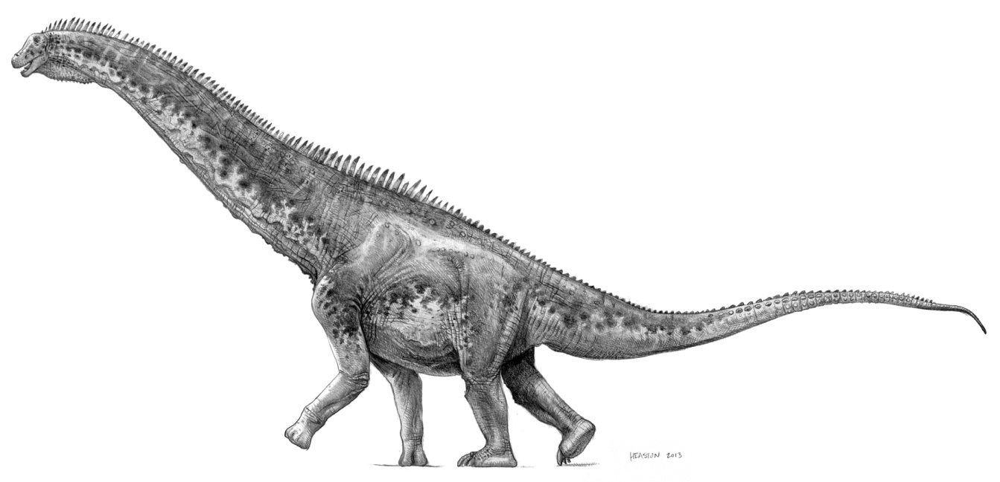

Monstrous Prey

Slide 13
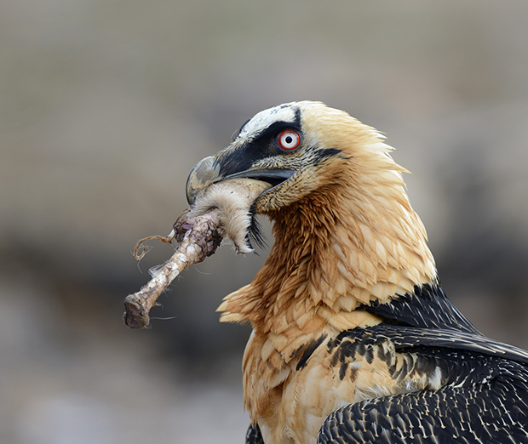
Bone Eaters

Slide 14
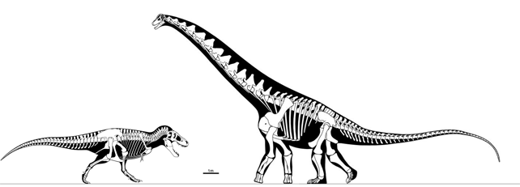
Juicy Bones
Bone (kg) = 0.065 * Mass(kg)^{1.071}
25,000kg Alamosaurus will have a 3,335kg skeleton
Notes:
Hyenas 4500
Saltwater crocs 16000

Slide 15
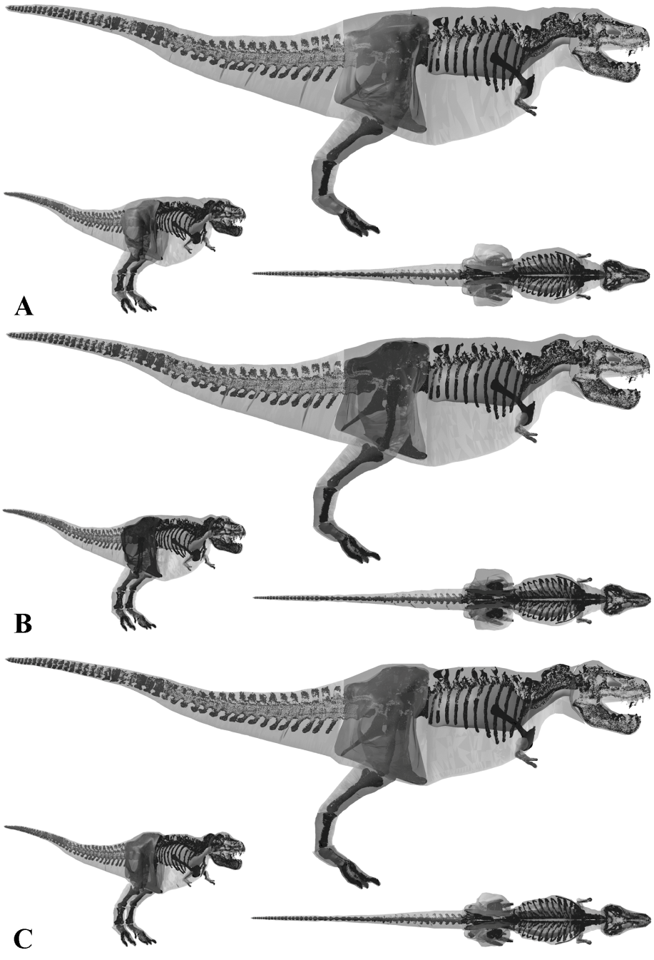
Numerical Model

Slide 16
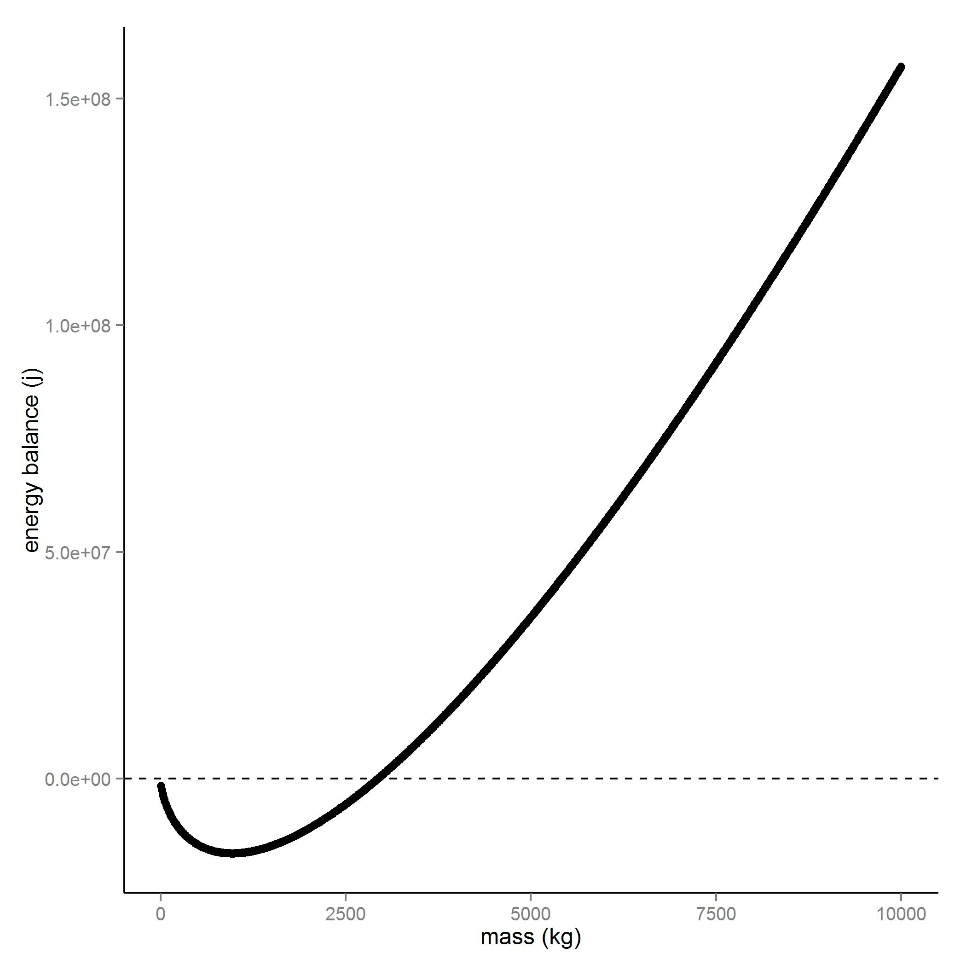
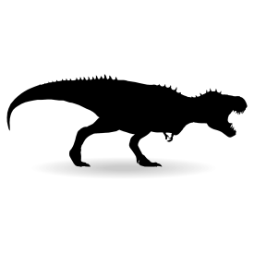
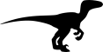
500m
Notes:
15% flesh 500 m detection radius

Slide 17
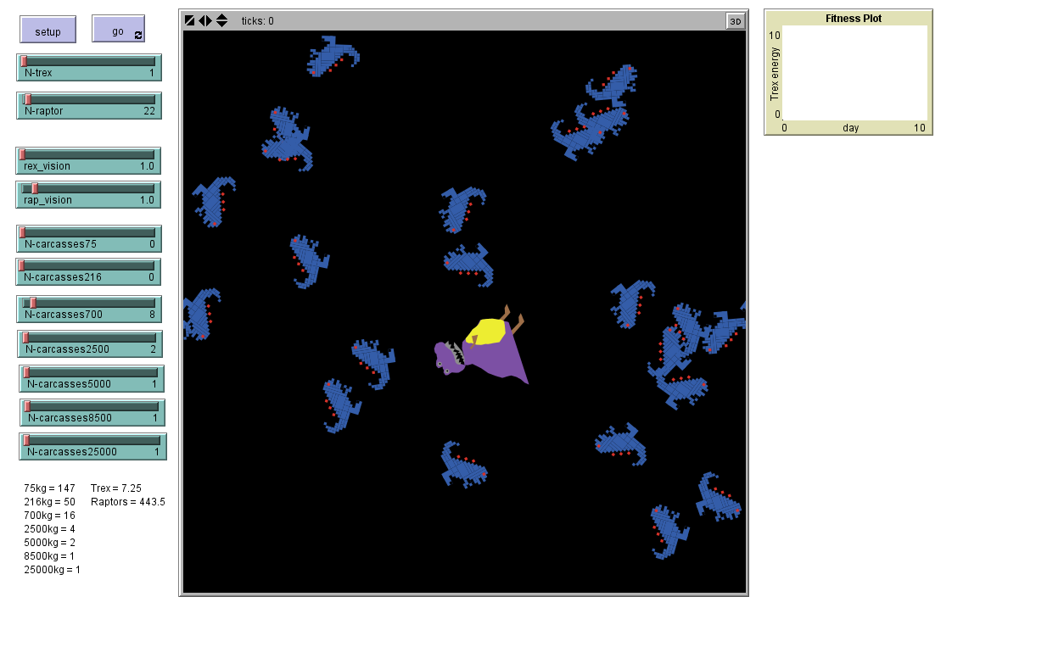
NetLogo Agent-based model

Slide 18
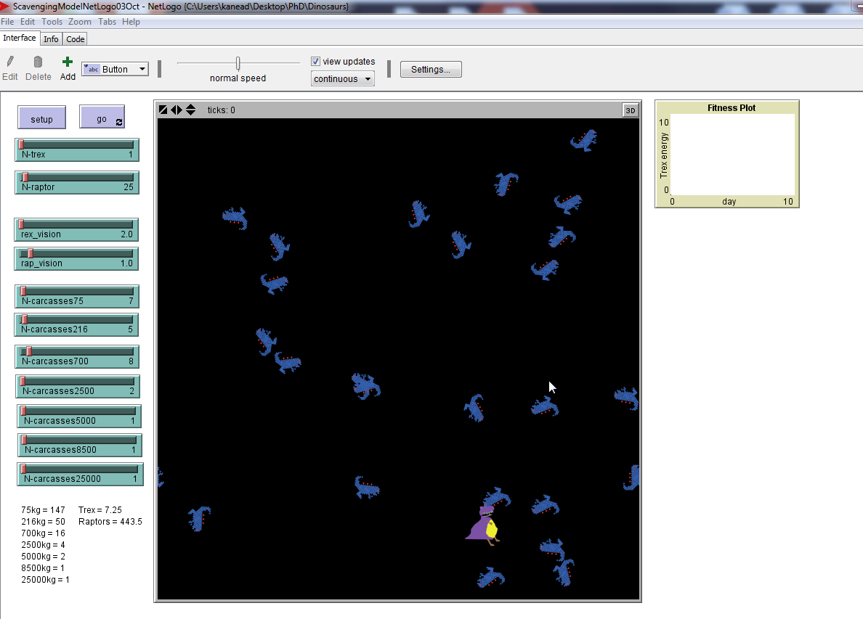

Slide 19
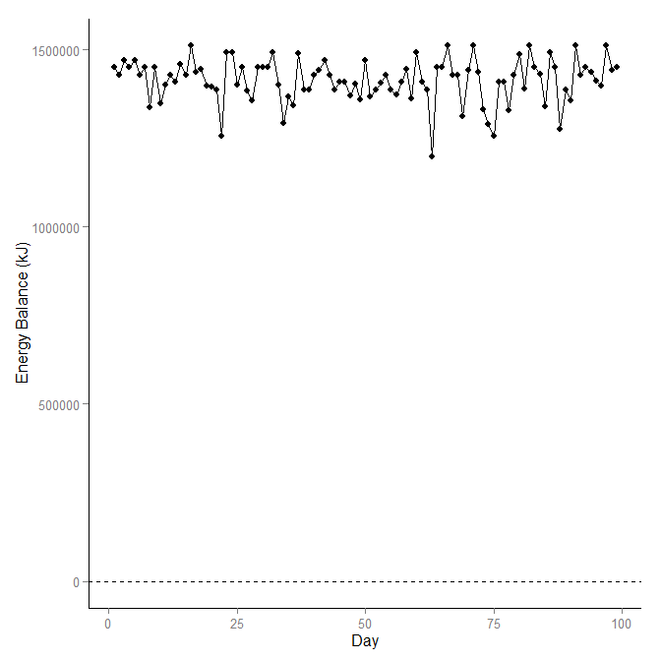

Slide 20


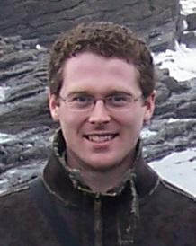
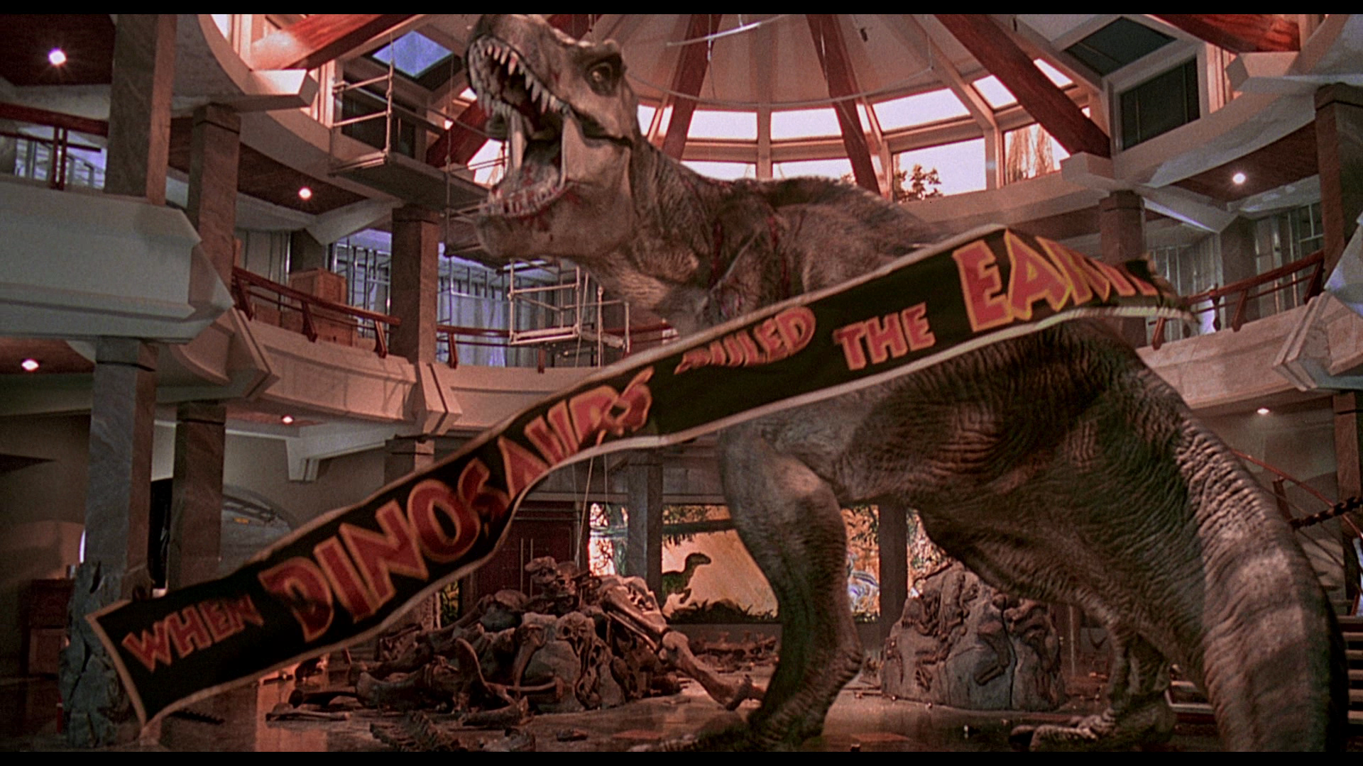
Kevin Healy, Graeme Ruxton & Andrew Jackson

Slide 21


